Slide 1

Basic Details of the Team and Problem Statement
Ministry/Organization Name/Student Innovation:
Ministry of Communications
PS Code: SIH 1413
Problem Statement Title: Dak Ghar Niryat Kendra
Team Name: Logisticoders
Team Leader Name: Navneet Sagar
Institute Code (AISHE):
Institute Name: Thapar Institute of Engineering and Technology
Theme Name: Transportation and Logistics

Slide 2








Idea/Approach Details
Home
⮚Idea
Our e-commerce website, integrated with Dak Ghar Niryat Kendra, empowers Indian MSMEs to showcase globally. International customers explore diverse categories for exceptional deals, gaining a comprehensive understanding of available offerings.
Login As
Buyer
Seller
Registration
Product Search
Admin
Dashboard
⮚Solution
Sub Category
An e-commerce website integrated with DNK’s website
Registration and login for:
1. Customers: Can easily navigate and explore a range of products, sorted by industries and their subcategories for a focused search.
2. Sellers: Can effortlessly list their products and efficiently manage incoming orders, streamlining their sales process.
3. Admin: To address and resolve concerns from both sellers and buyers, ensuring a smooth and satisfactory experience for all parties involved.
Resolving buyer and seller queries.
Feedback
Sales Statistics
Product Specifications
Place Order
Customer rating and Feedback from buyers
Visual depiction and filtering order based on sales
Feedback

Slide 3

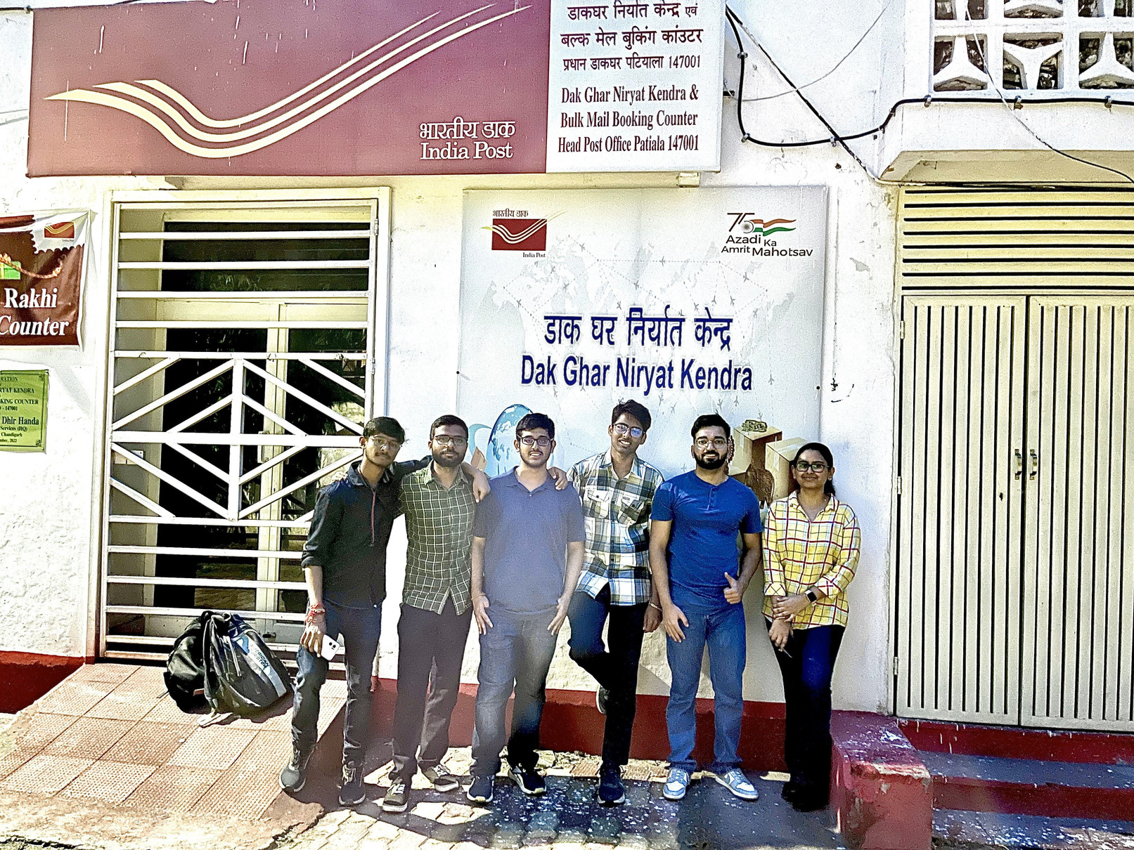
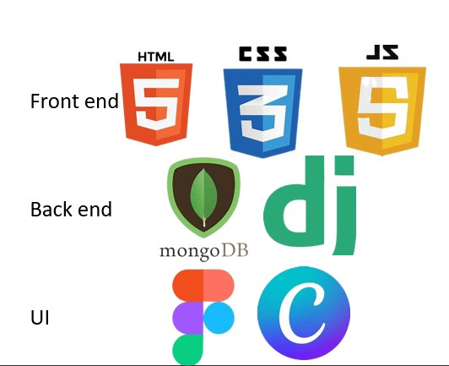
Showstoppers
DNK Promotion: Introducing a homepage slideshow to showcase DNK's operations.
Multilingual Chatbot: Offering a multilingual chatbot for seller and customer assistance.
Product Highlight: Curating top-selling products in subcategories section (based on feedbacks) to enhance the shopping experience and encourage seller competition.
Admin Reports: Providing admin support for bug and fraud reports to improve website legitimacy .
Bulk Order Discounts: Offering discounts for bulk orders to buyers.
Location Finder: Enabling sellers to find nearby Daak Ghar Niryaat Kendra via Google Maps.
Shipment Tracking: Allowing customers to visually track shipment progress and location.
Tech-stack
used:
Front End
Dependencies:
Back End
It requires a proper internet connection.
UI/UX

Slide 4
Team Member Details
Team Leader Name: Navneet Sagar
Branch: BTech | Stream : COE | Year : II
Team Member 1 Name: Isha Walia Branch: BTech | Stream : ENC | Year : II
Team Member 2 Name:Krish Kumar Branch : BTech | Stream :COE | Year : II
Team Member 3 Name: Vardhan Singh Rawat
Branch : BTech Team Member 4 Name: Inesh Kumar | Stream :COE | Year : II
Branch : BTech | Stream :COE | Year : II
Team Member 5 Name: Bhavya Jaiswal Branch : BTech | Stream :COE | Year : II
Team Mentor 1 Name: Sachin Kansal Category : Academic | Expertise: Robotics ,Computer Vision, Mechatronics | Domain Experience: 10 years

